Slide 1


OWASP Application Security Frameworks
24-03-2022

Slide 2

Agenda
ASVS
MASVS

Slide 3
OWASP ASVS - Application Security Verification Standard 4.0.3
It is latest standard defined by OWASP on top of OWASP Top 10
ASVS is aligned with NIST for authentication and Session management
Help organizations develop and maintain secure applications.
Allow security service vendors, security tools vendors, and consumers to align their requirements and offerings.
ASVS has 3 levels –
ASVS Level 1 is for low assurance levels, and is completely penetration testable
ASVS Level 2 is for applications that contain sensitive data, which requires protection
ASVS Level 3 is for the most critical applications - applications that perform high value transactions, contain sensitive medical data, or any application that requires the highest level of trust.

Slide 4
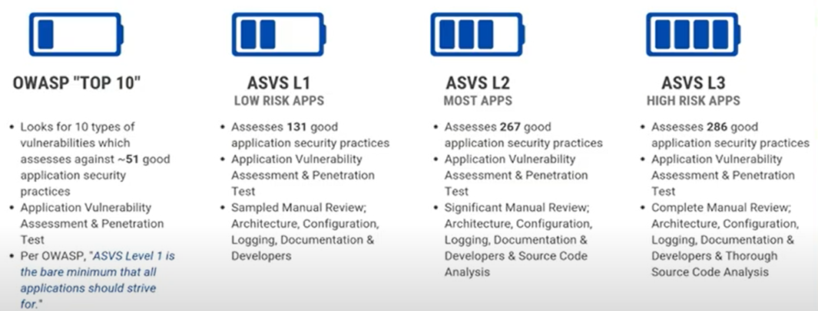
OWASP ASVS

Slide 5
Philosophy of ASVS
ASVS
Standard for how to verify the security of web applications
It is application independent
It is development life cycle independent
It defines requirements that can be applied across web applications without special interpretation

Slide 6
ASVS Level 1 : Basic
This level is for basic applications which don’t have confidentiality as a priority and are less vulnerable to cyber attacks.
This basic level of security assurance must be fulfilled by each and every application
All the measures are penetration testable without requiring access to source code or configurations
Level 1 controls can be checked either automatically by tools or simply manually without access to source code
Threats to the application will most likely be from attackers who are using simple and low effort techniques to identify easy-to-find and easy-to-exploit vulnerabilities.

Slide 7
ASVS Level 2 : Standard
The applications which regularly handle business to business transactions must follow the level 2 guidelines
The security controls mentioned in this level protect the application from invalid access control, injection flaws, authentication, and validation errors, and so on
This level ensures that the controls for security effectively align with the level of threat the application is exposed to.
Threats to Level 2 applications will typically be skilled and motivated attackers focusing on specific targets using tools and techniques that are highly practiced and effective at discovering and exploiting weaknesses within applications

Slide 8
ASVS Level 3 : Advanced
This is the highest level of security that can be built into an application.
is generally preferred by applications which aim for a significant level of security like healthcare, military, and other critical applications.
This level require applications to build security layers from the beginning and also document and audit their efforts.
Requires more in-depth analysis of architecture, coding, and testing than all the other levels.

Slide 9
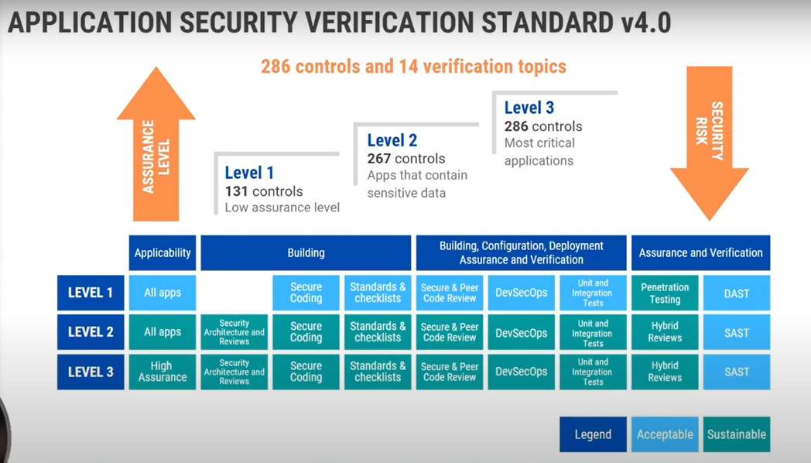
ASVS Levels

Slide 10
Uses of ASVS
Detailed Security Architecture Guidance
As a Replacement for Off-the-shelf Secure Coding Checklists
As a Guide for Automated Unit and Integration Tests
For Secure Development Training
As a Driver for Agile Application Security
As a Framework for Guiding the Procurement of Secure Software

Slide 11
Domains of ASVS
There are 14 domains supported by ASVS

Slide 12
V1: ARCHITECTURE, DESIGN AND THREAT MODELLING REQUIREMENTS
Covers the elementary features of all security architectures, i.e. privacy, availability, confidentiality, non-repudiation, and integrity.
Each of these security principles must be built in and be innate to all applications.
It is critical to "shift left", starting with developer enablement with secure coding checklists, mentoring and training, coding and testing, building, deployment, configuration, and operations, and finishing with follow up independent testing to assure that all of the security controls are present and functional.

Slide 13
V2: AUTHENTICATION VERIFICATION REQUIREMENTS
In combination of username and password , hashing and other advanced cryptographic methods, need to be implemented.
Use of Cryptographic security keys which are smart cards, where the user has to plug in or pair the cryptographic device to the computer to complete authentication.
Single-factor One-time Passwords (OTPs) are physical or soft tokens that display a continually changing pseudo-random one-time challenge. These devices make phishing (impersonation) difficult, but not impossible.
Look up secrets are pre-generated lists of secret codes. These lookup codes are used once, and once all used, the lookup secret list is discarded.
Encourage use of Multi Factor Authentication

Slide 14
V3: SESSION MANAGEMENT VERIFICATION REQUIREMENTS
This portion of the OWASP ASVS makes sure the application in focus has the following session management features:
Sessions can not be shared or guessed and are unique for everyone.
Session timeout occurs after an adequate period of inactivity and the session becomes invalid.
TLS or another secure transport channel is mandatory for session management.
Session timeouts have been aligned with NIST 800-63
Token-based session management including JWT, OAuth, SAML, and API keys.

Slide 15
Half open attack
Attackers start a half-open attack by attempting to lock, reset, or recover a credential. A popular session management design pattern re-uses user profile session objects/models between unauthenticated, half authenticated (password resets, forgot username), and fully authenticated code. This design pattern populates a valid session object or token containing the victim's profile, including password hashes and roles. If access control checks in controllers or routers does not correctly verify that the user is fully logged in, the attacker will be able to act as the user. Attacks could include changing the user's password to a known value, update the email address to perform a valid password reset, disable multi-factor authentication or enroll a new MFA device, reveal or change API keys, and so on.H

Slide 16
V4: ACCESS CONTROL VERIFICATION REQUIREMENTS
This chapter of the document sets up guidelines to make sure that the application fulfills the following access control requirements:
Only those with the required credentials can access the resources in focus.
Specific privileges and roles are assigned to only a certain set of users.
Access control and permission metadata are secured effectively to prevent tampering and theft.
Verify administrative interfaces use appropriate multi-factor authentication to prevent unauthorized use.

Slide 17
V5: VALIDATION, SANITATION AND ENCODING VERIFICATION
The chapter on validation, sanitation, and encoding requirements sets up standards such that:
Injection attacks should be prevented by setting up a secure pipeline for input validation and output encoding.
Input data is properly validated and filtered, i.e. its range and length are checked properly.
Output data is properly encoded and its context well-protected from infiltrators.
carefully chosen output encoding is critical to the security of the application.
Properly implemented input validation controls, using positive allow lists and strong data typing, can eliminate more than 90% of all injection attacks.

Slide 18
V6: STORED CRYPTOGRAPHY VERIFICATION REQUIREMENTS
The chapter on cryptography stresses on the following key factors:
Make sure that the application’s error handling is robust and all the cryptographic modules used are fail-safe.
An efficient random number generator is used which meets the purpose of the application’s cryptographic requirements.
Secure access to the cryptographic keys is maintained.

Slide 19
V7: ERROR HANDLING AND LOGGING VERIFICATION REQUIREMENTS
The seventh chapter in the ASVS 4.0 document is about logging and error handling and focuses on the following criterion:
Do not collect or create logs of sensitive user information unless necessary.
Make sure that the logged data is handled with the utmost care and protected according to compliance requirements.
Make sure that the collected data is not retained for long and is deleted after a certain specified duration of time.

Slide 20
V8: DATA PROTECTION VERIFICATION REQUIREMENTS
The chapter on data protection requirements stresses more on the aspects of confidentiality, integrity, and availability:
The confidentiality of the data must be maintained during both storage and transit.
Data must be protected from malicious alteration or deletion by threat actors.
The availability of data must be ensured to always authorized users.

Slide 21
V9: COMMUNICATION VERIFICATION REQUIREMENTS
The chapter on communication requirements guides the developers to always use strong encryption or transport layer security.
Advised to use the most novel configuration algorithms and reduce reliance on the weak and soon to be deprecated ones.
Recommended practice to disable the insecure cyphers and algorithms in order to maintain the security of the application data.

Slide 22
V10: MALICIOUS CODE VERIFICATION REQUIREMENTS
The chapter on malicious code aims to make sure that the following high-level requirements are met:
Handling of malicious activity is done in a manner so that the rest of the application is not affected by it.
The application in focus doesn’t have entities like time bombs (time-based attacks), easter eggs, rootkits, or other unauthorized material that could be controlled or executed by the threat actors.

Slide 23
V11: BUSINESS LOGIC VERIFICATION REQUIREMENTS
The eleventh and one of the most crucial chapters of the document makes sure that the following business logic requirements are met:
The business logic is designed in a manner so that it can’t be bypassed by threat actors.
That the business logic flow is processed in order and is sequential.
The business logic has flags to detect attacks and mitigate them.
The business logic is designed to address security flaws like repudiation, spoofing, data theft, tampering, and other attacks.

Slide 24
V12: FILE AND RESOURCES VERIFICATION REQUIREMENTS
This chapter in the ASVS 4.0 document deals with the following file and resource requirements:
Data from untrusted sources must be handled in a manner compliant with regulations.
Data from third-party and untrusted sources must be stored out of the webroot and given limited permissions

Slide 25
V13 API AND WEB SERVICE VERIFICATION REQUIREMENTS
This part of the standard recommends that the APIs of the application fulfill the following requirements:
The APIs have adequate authorization, essential session management parameters, and authentication to access all the web services.
The APIs have proper input validation in case its parameters are transiting from lower to higher trust levels.
The various application APIs like the cloud and serverless APIs have all the essential security controls.

Slide 26
V14: CONFIGURATION VERIFICATION REQUIREMENTS
The last chapter in this OWASP standard concerns several configuration requirements including:
The build environment of the application must be secure and automatable.
The third-party libraries must be adequately assessed, and the application must have a suitable configuration and dependency management system to filter out the insecure components.

Slide 27
OWASP ASVS Checklist for Security Audit
The ASVS checklist for security audits consists of the following sections covering verification requirements on all the three ASVS levels.
Architecture: This section on the checklist covers requirements across all the 14 chapters ranging from verification of the use of threat modeling to verifying the application’s trust boundaries and access control mechanisms.
Authentication: The checklist of authentication covers requirements like verifying password security credentials, credential storage requirements, and service authentication requirements.
Session Management: The checklist section on session management covers the intricacies ranging from session logout and timeout requirements to cookie-based and token-based session management.
Access Control: This portion of the checklist stresses on verifying general access control design to operation levels access control requirements like sensitive data and API security.

Slide 28
OWASP ASVS Checklist for Security Audit
Input Validation: This checklist section guides developers to verify that all input is validated using adequate validation and that user input is properly sanitized to avoid injection attacks. ●
Cryptography at Rest: This portion of the checklist requires the developers to verify that sensitive user, financial or healthcare data is stored encrypted and that proper algorithms and ciphers are used to authenticate the encrypted data. ●
Error Handling and Logging: This section on error handling and logging provides security guidelines for verifying the contents of logs, log processing requirements, and log protection requirements. ●
Data Protection: This part enlists detailed requirements on general and client-side data protection and also on sensitive data protection. ●
Communication Security: This checklist for security audit highlights verification requirements like the use of trusted TLS certificates, authentication of server communications, and so on.

Slide 29
OWASP ASVS Checklist for Security Audit
Malicious Code: This section stresses on verifying the use of code analysis tools, managing permissions, malicious code search, and verifying deployed application integrity controls. ●
Business Logic: All the verification requirements related to the application’s business logic are enlisted in this section. ●
Files and Resources: All the file related security requirements including upload, integrity, execution, storage, download, and SSRF protection requirements are enlisted here. ●
Web Service: Security requirements like generic web service, RESTful web service, SOAP web service, and GraphQL based verification requirements are covered in this section. ●
Configuration: This section of the checklist on configuration covers the build, dependency, unintended security disclosure, and HTTP security headers related requirements.

Slide 30
ASVS Checklist
https://github.com/shenril/owasp-asvs-checklist
https://owasp.org/www-pdf-archive/OWASP_Application_Security_Verification_Standard_4.0-en.pdf

Slide 31
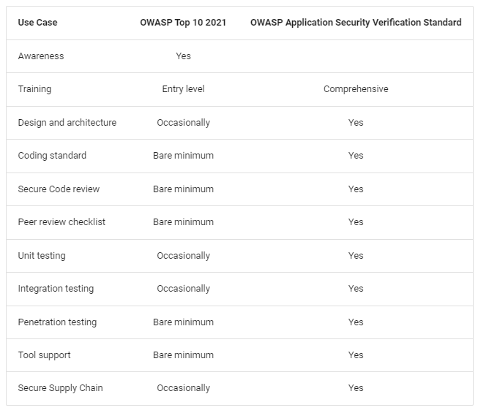
Recommendations for OWASP Top 10 and ASVS

Slide 32
Basic Difference…
Web App | Mobile App
Built using HTML, CSS, JS | Built using specific programming language
Loaded from Browser | Run on specific platform
Easy to Build and maintain | Complex to build
Cheaper | Expensive
Single app for all platforms | Specific app for each OS
Slower | 1.5 times faster
Less Secure | More Secure

Slide 33
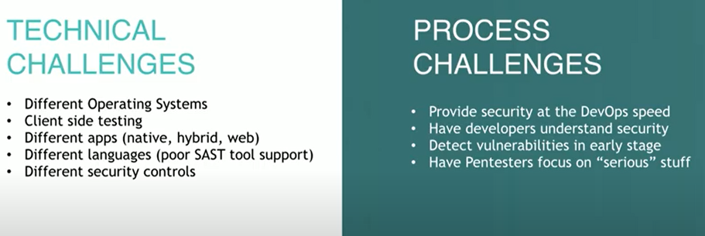
Mobile Security Challenges

Slide 34
OWASP Mobile Top Ten Security Risks / Vulnerabilities
Improper Platform Usage
Insecure Data Storage
Insecure Communication
Insecure Authentication
Insufficient Cryptography
Insecure Authorization
Client Code Quality
Code Tampering
Reverse Engineering
Extraneous functionality

Slide 35
MASVS - Mobile Application Security Verification Standard (MASVS).
Culmination of community effort and industry feedback
Framework of security requirements needed to design, develop and test secure mobile apps on iOS and Android
OWASP Mobile Project Slack channel: https://owasp.slack.com/messages/project-mobile_omtg/details/

Slide 36
MASVS Objectives
Use as a metric
To provide a security standard against which existing mobile apps can be compared by developers and application owners
Use as guidance
To provide guidance during all phases of mobile app development and testing
Use during procurement
To provide a baseline for mobile app security verification.

Slide 37
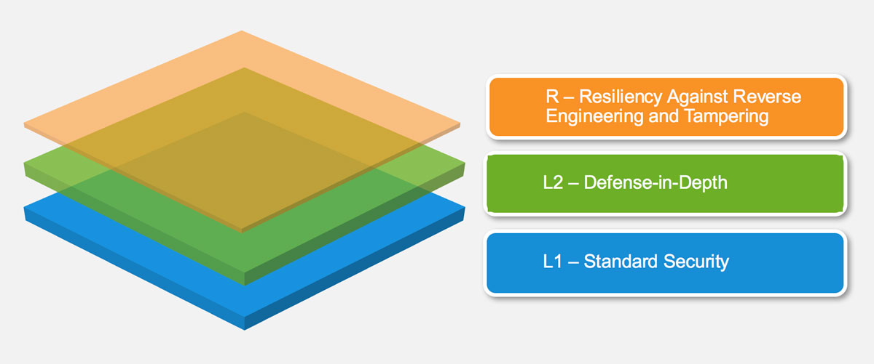
MASVS Levels

Slide 38
MASVS Mobile AppSec Model

Slide 39
MASVS Mobile AppSec Model

Slide 40
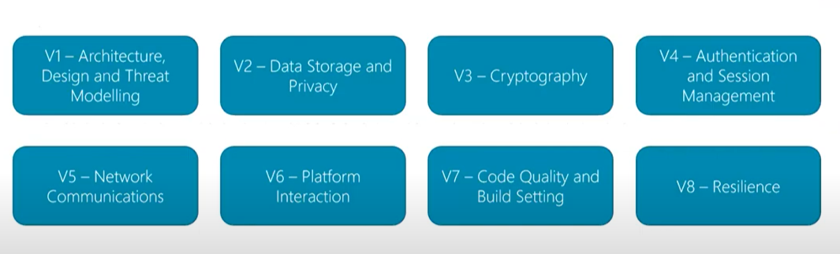
MASVS Security Requirements

Slide 41
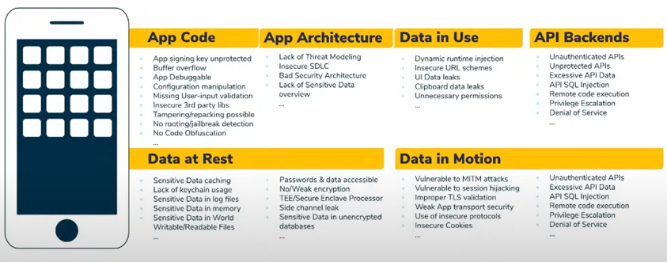
Mobile Attack Surface

Slide 42
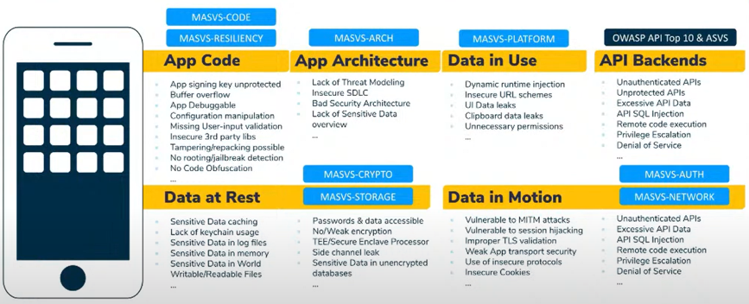
OWASP MASVS for Mobile Attacks

Slide 43
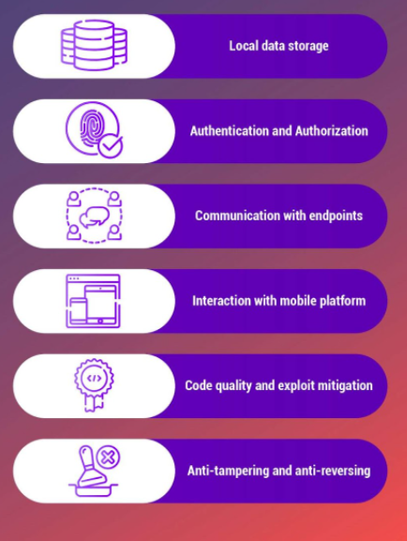
Key Areas in Mobile App Security

Slide 44
Top 5 Areas To Focus OWASP MASVS
Insecure Data Storage and Crypto
Insecure Network Communication
Insecure Authentication or Authorization
Insecure Coding Practices
Reverse Engineering and Anti-Tampering

Slide 45
Insecure Data Storage & Crypto

Slide 46
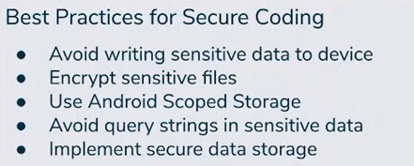
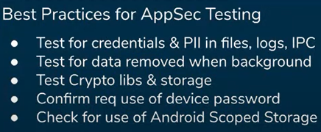
Best Practices

Slide 47
Insecure Network Communication

Slide 48
Best Practices

Slide 49
Insecure Authentication or Authorization

Slide 50
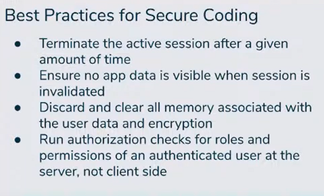
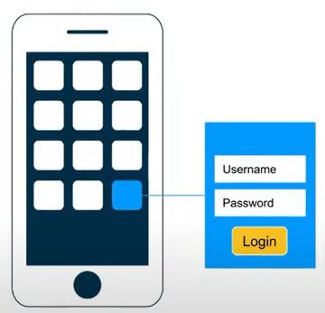
Best Practices

Slide 51
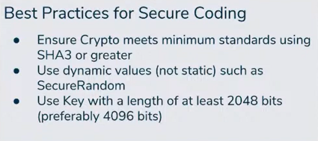
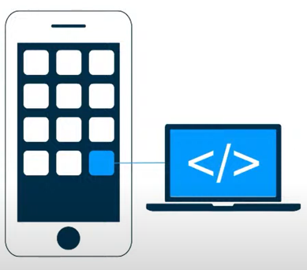
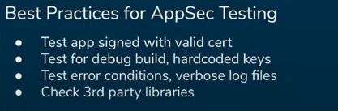
Insecure Coding Practices

Slide 52
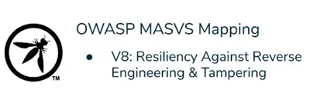
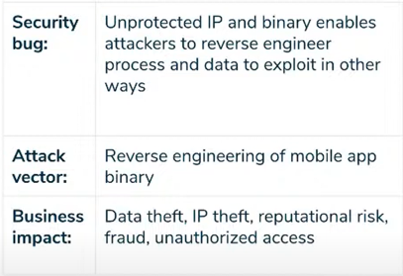
Reverse Engineering
Reversing Tools – Frida, Radare, 2Frida Repo

Slide 53
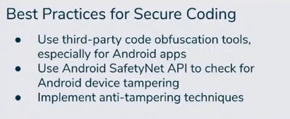
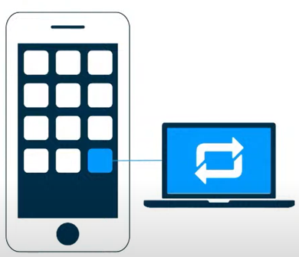
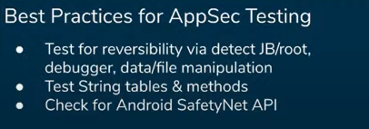
Best Practices

Slide 54
OWASP MSTG – Mobile Security Testing Guide
The OWASP Mobile Security Testing Guide (MSTG) is a comprehensive manual for testing the security of mobile apps.
It describes processes and techniques for verifying the requirements listed in the Mobile Application Security Verification Standard (MASVS)
Provides a baseline for complete and consistent security tests.
This guide focuses on Native apps for Android and iOS running on smartphones

Slide 55
Reference Documents
MASVS
MSTG
MSTG Checklist

Slide 56
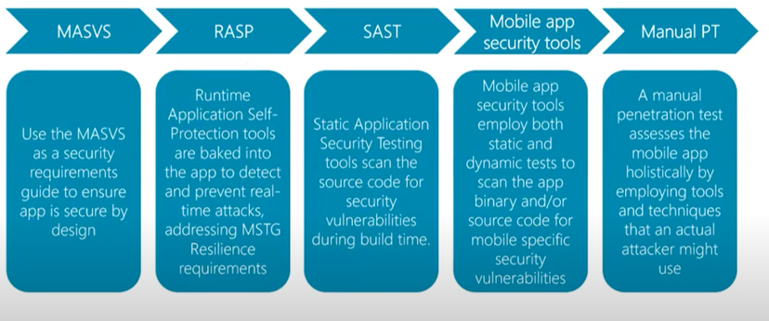
Securing Mobile App SDLC

Slide 57
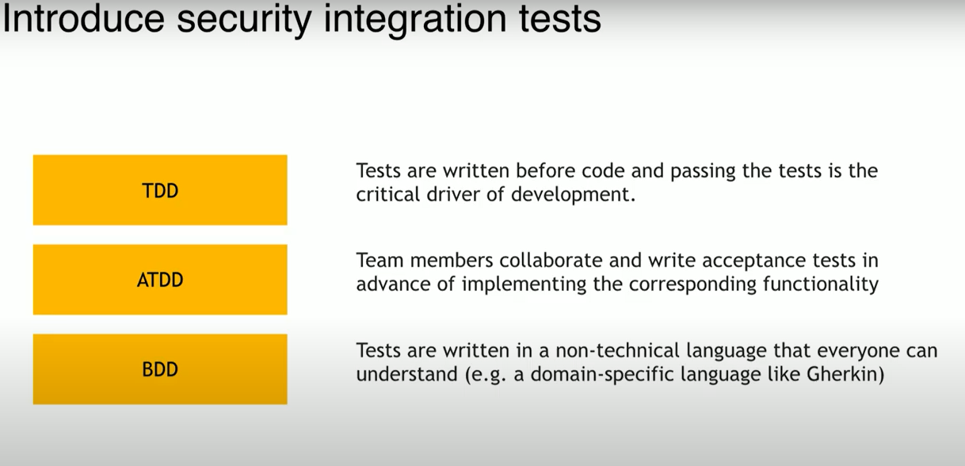

Slide 58
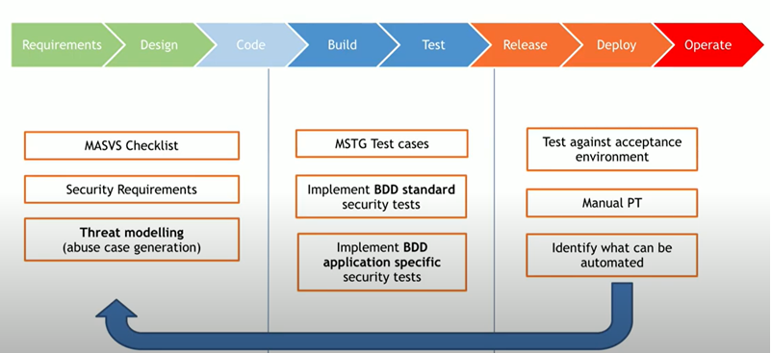
Complete SDLC Process

Slide 59
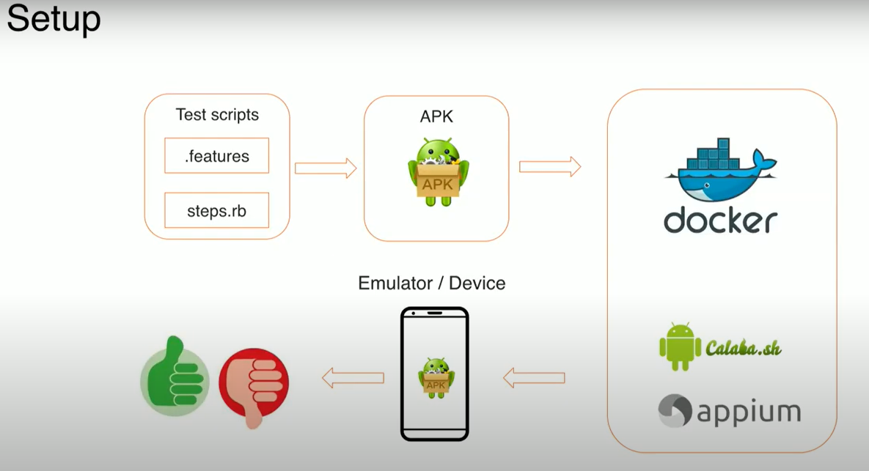
Mobile App Setup

Slide 60
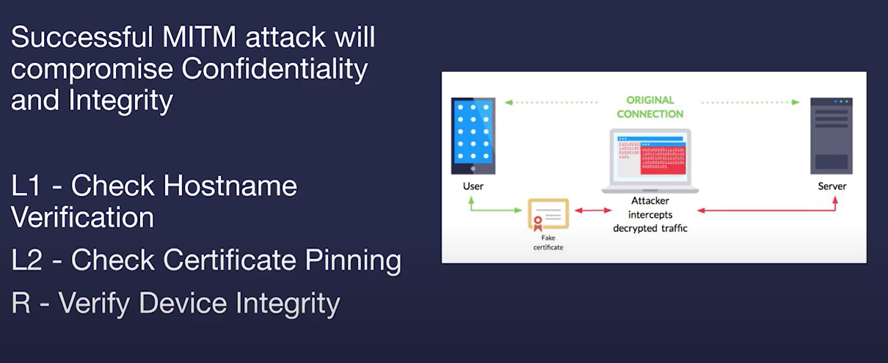
Man-In-The-Middle (MITM) Attack

Slide 61
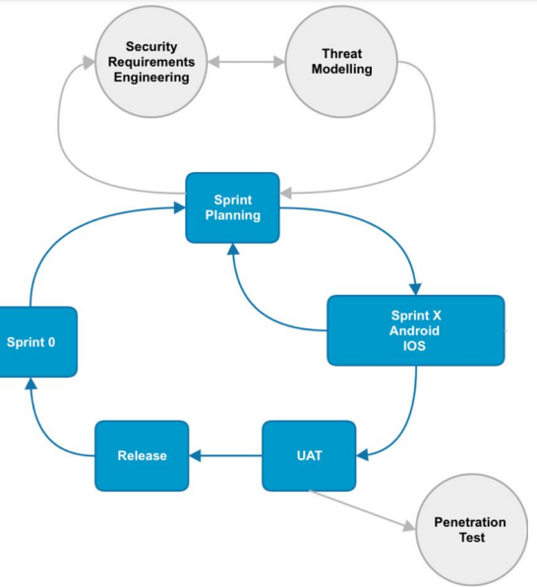
Agile Inclusion

Slide 62

Thank You!
Jolly.trivedi@ltts.com

